Slide 1
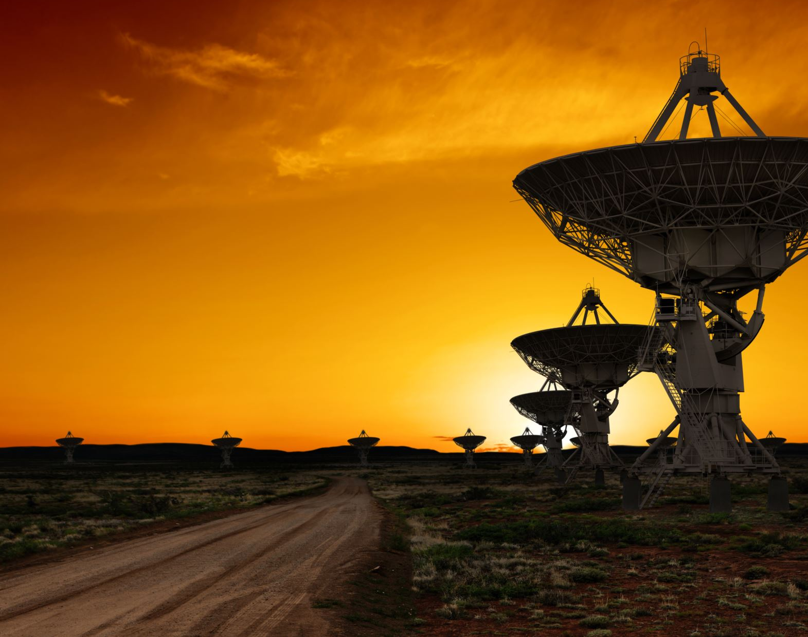
Low-latency Downlink for LEO Satellites
Jay Shenoy
Deepak Vasisht, Ranveer Chandra
Notes:
Hi everyone, I’m Jay from UIUC and today I’ll be talking about a novel approach for Low-Latency Downlink with LEO satellites.
In this project, I’ll be describing an efficient design that help data get from satellites in space down to Earth. This is a joint work with my advisor Deepak and our collaborator from Microsoft Ranveer.

Slide 2
GEO (Conventional)
36,000 km
LEO
600 km
Source: UCS Satellite Database

Slide 3
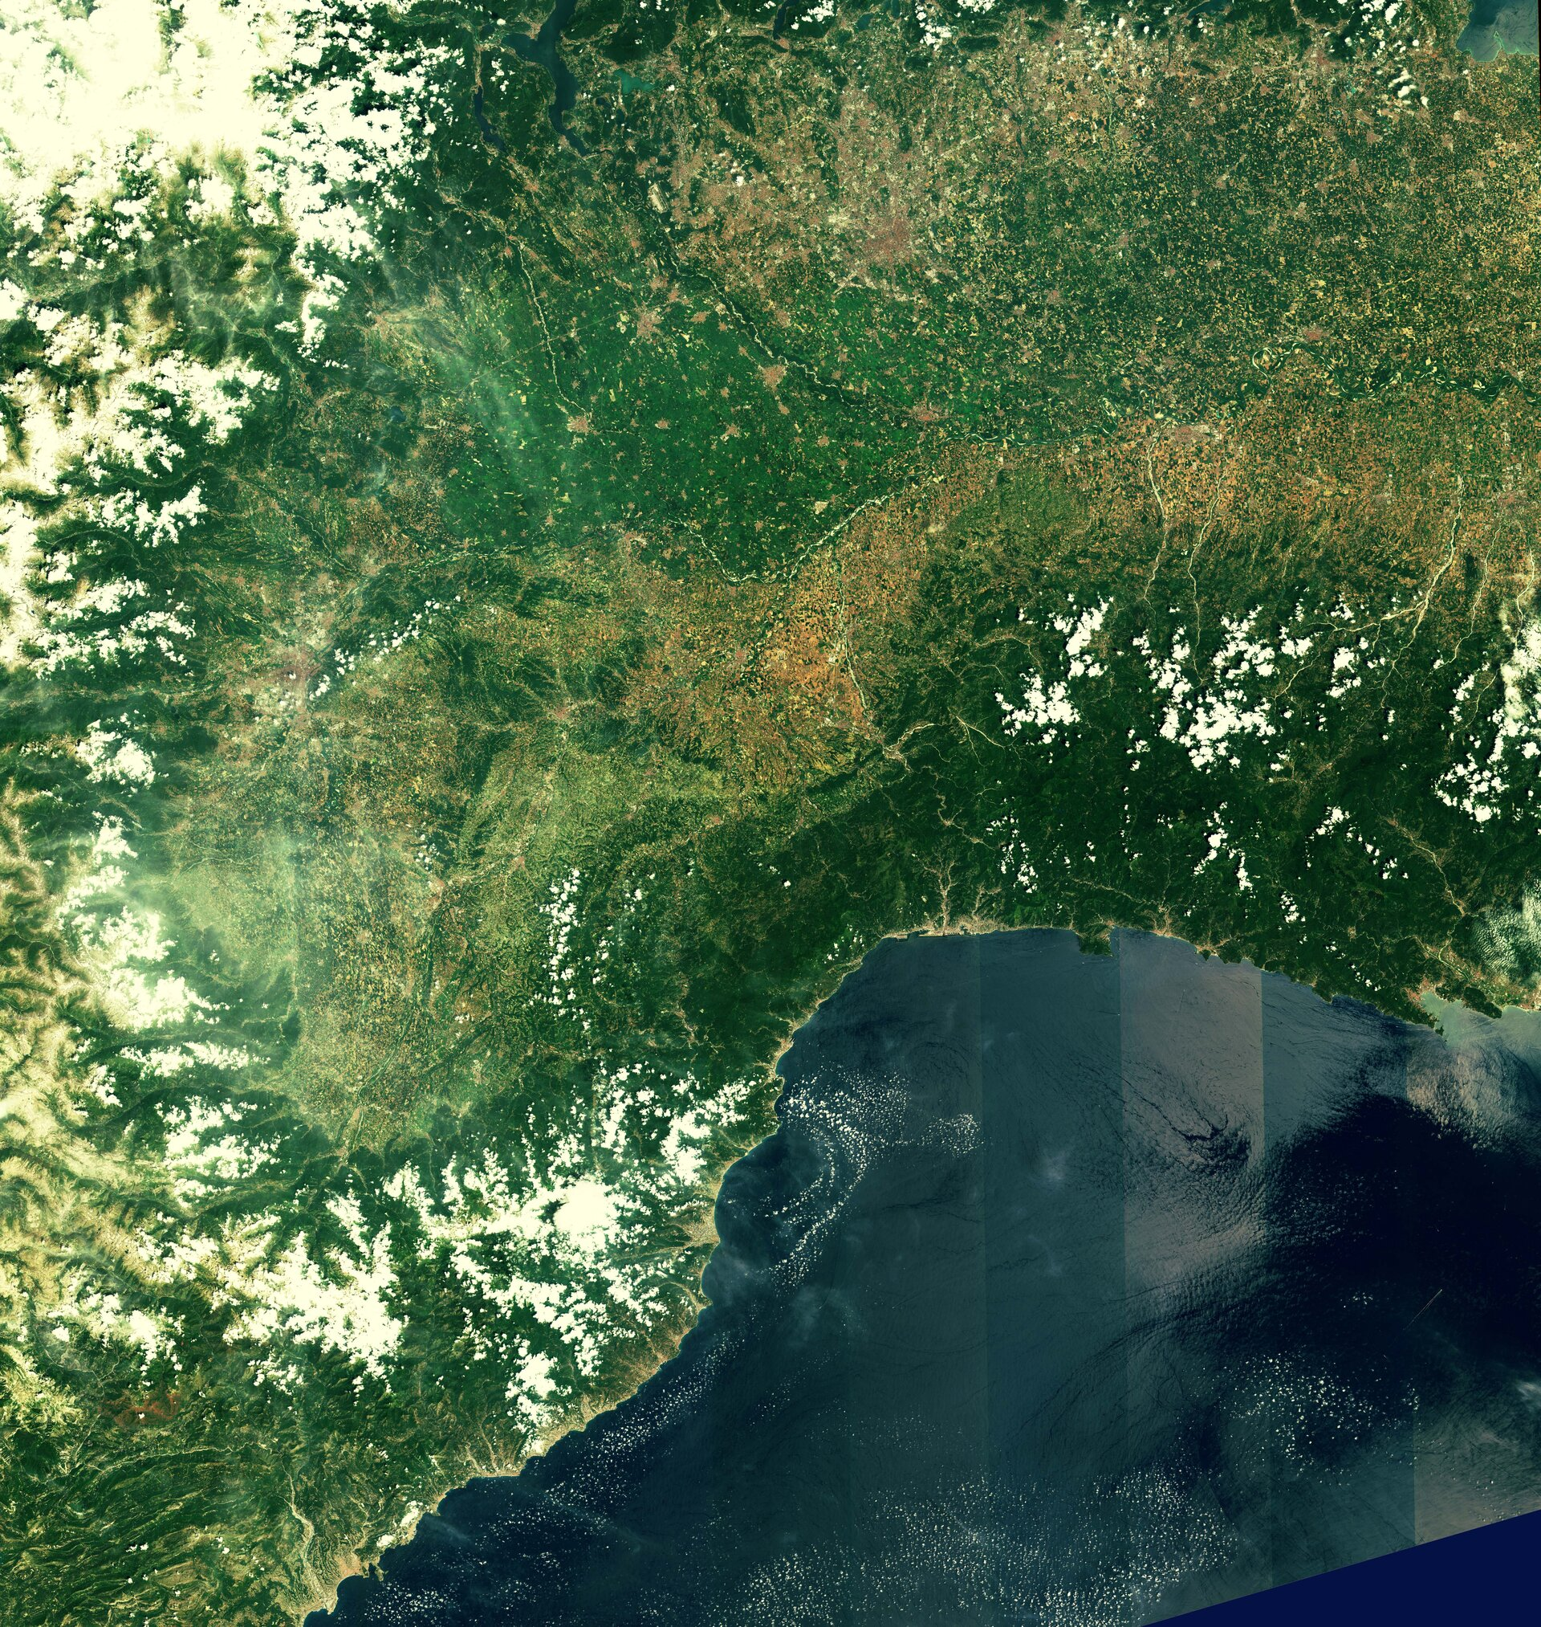
Today, 45% of LEO satellites are Earth Observation
Sensing from Space
Notes:
Out of the 3000 LEO satellites orbiting Earth today, about 45% of them are Earth Observation satellites. These Earth observation satellites take pictures of the Earth from space and send them down to the ground. And on Earth we have ground stations that wirelessly receive these images.

Slide 4
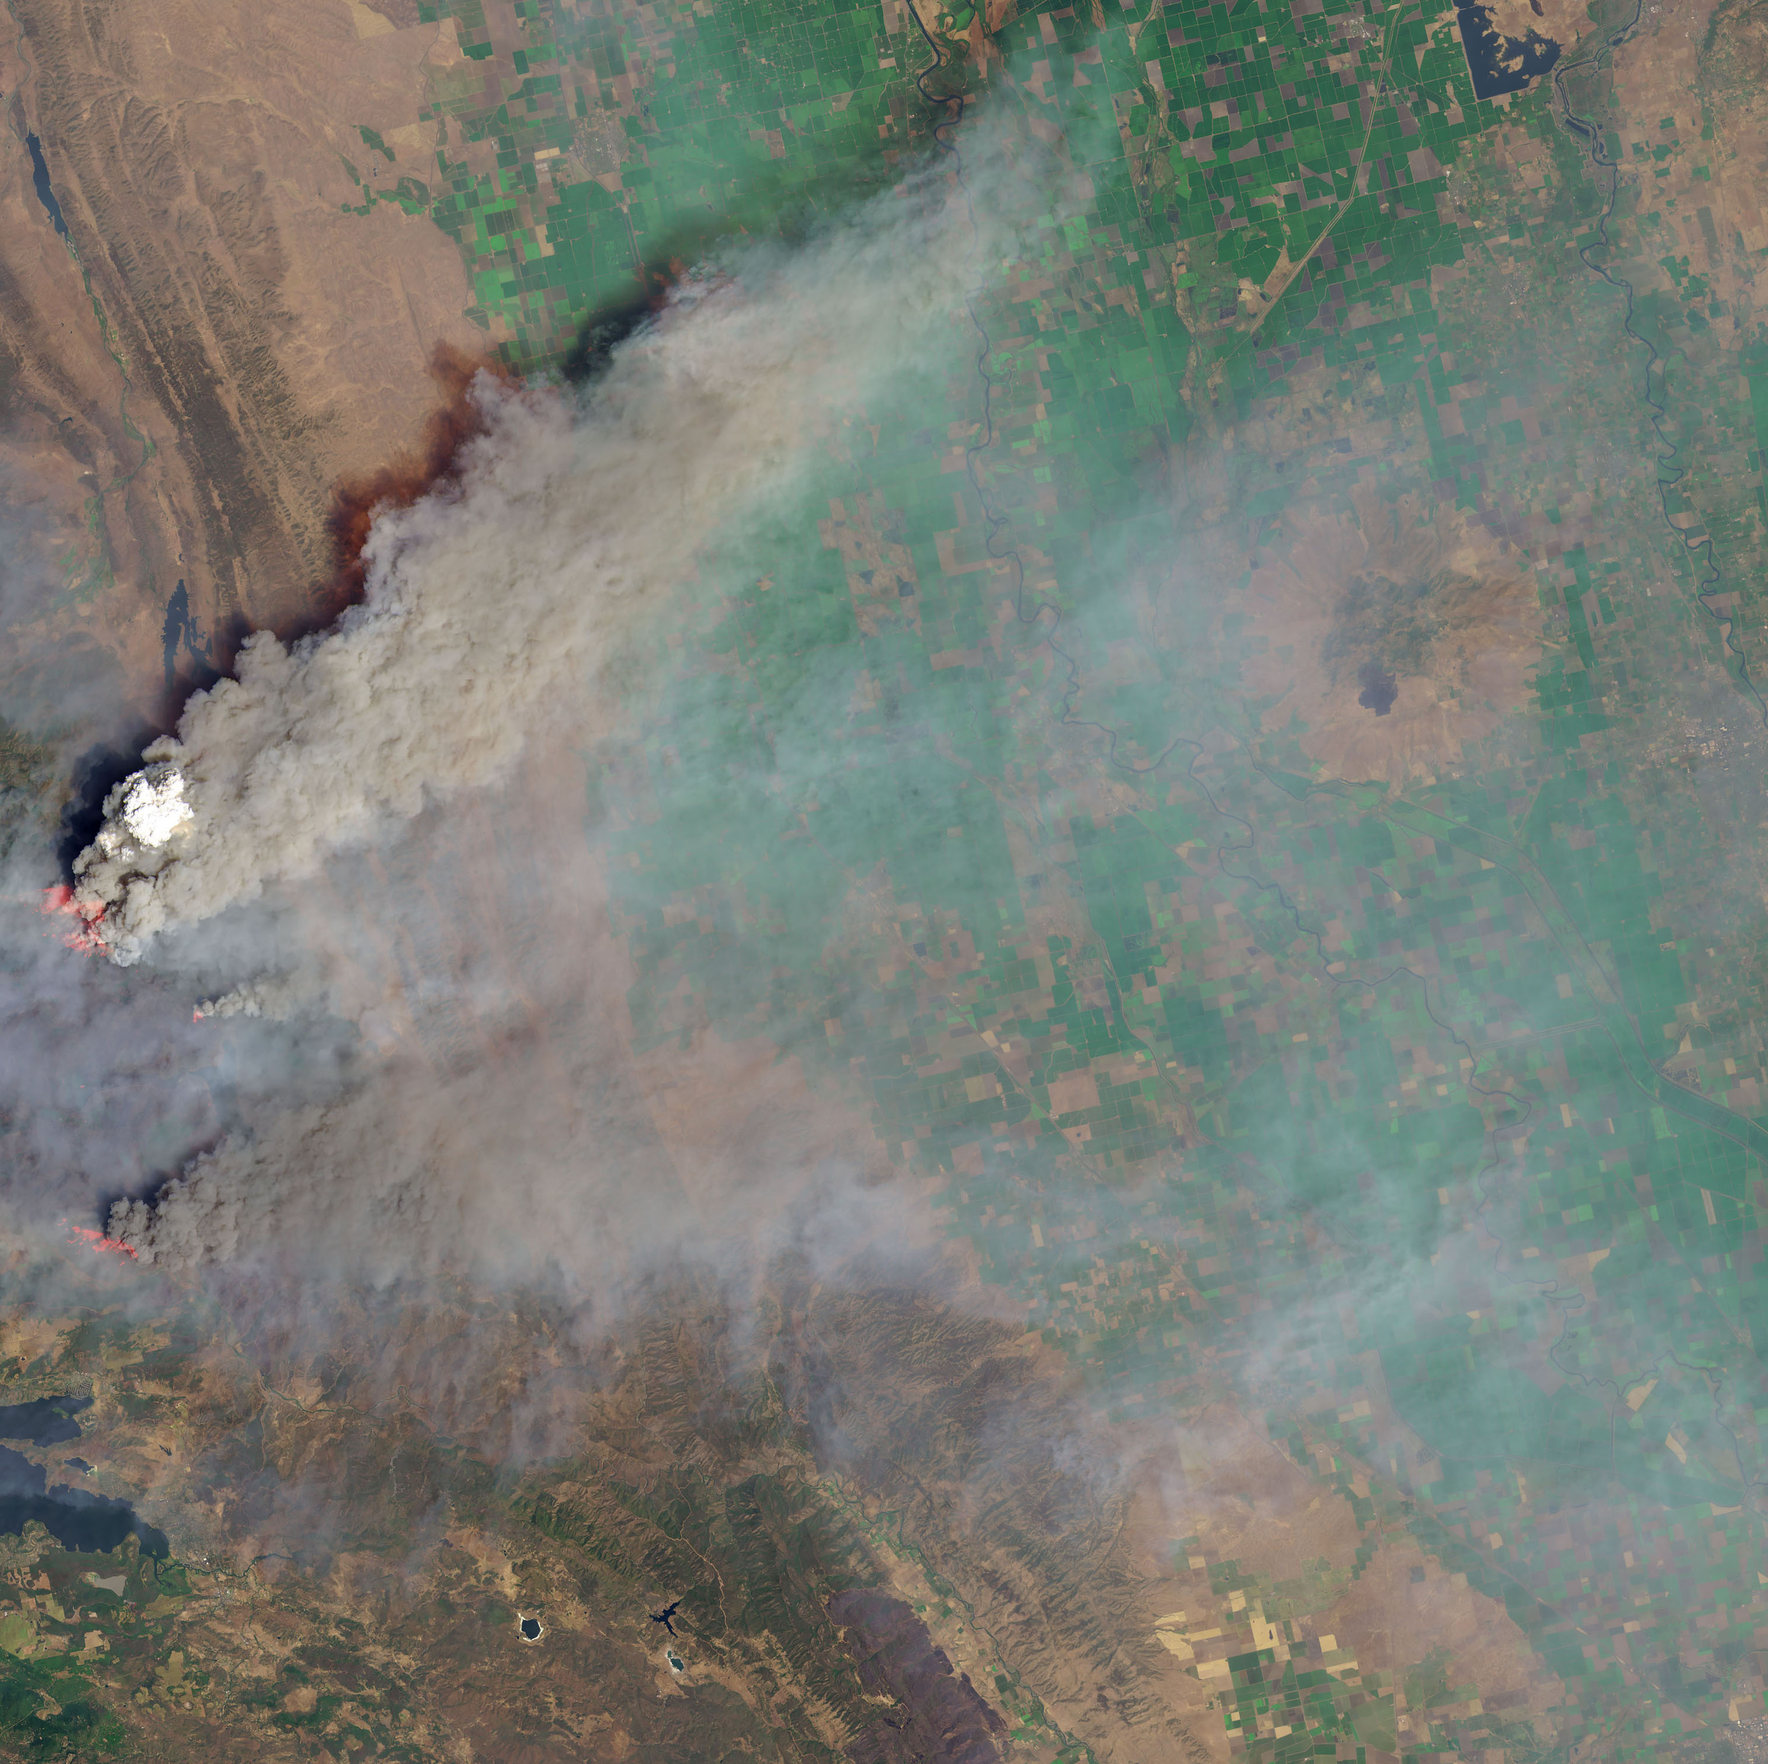
Earth Observation Applications: Disaster Monitoring
Early detection
Tracking propagation
Notes:
As these satellites travel, they take pictures of the Earth. Almost everyday on the news we hear stories of wildfires causing a lot of environmental destruction. And given climate change, we can expect these natural disasters to occur more and more frequently. But this is a place where Earth observation satellites can really shine. The fine grained imagery that these satellite provide can be used by emergency response detect and extinguish fires before they even begin. We can also use this imagery to track the spread of wildfires and plan our rescue efforts to both minimize both the damage and casualities caused by such natural disasters. And this is just one application of satellite imagery, in fact there are many more including ocean monitoring, agriculture, and smart cities. As a result, it is essential that we obtain satellite image data as frequently and as real-time as possible in order to gain a better and more accurate understanding of these environmental events.
News forest fires
LEO EO can provide imagery to mitigate fires
Other applications
Must get data in real time
Faster

Slide 5
Earth Observation Satellites
Notes:
LEO satellites typically orbit only a couple hundred km away from the earth’s atmosphere. On average, it takes around 90 min for them to orbit the earth once, meaning they can pass over the same point on Earth multiple times a day. As these satellites orbit, they scan the earth and collect imagery. In the span of 5-6 days, a satellite can orbit over and image the entire Earth.

Slide 6
Earth Observation Satellites

Slide 7
Challenge: Data Downlink
Single image of Earth is 500 terra-pixels
100s GB of Data per satellite per day
Each contact lasts nearly 10 minutes
Notes:
However, there are some significant challenges with LEO Earth Observation satellites. With the high resolutions of imagery we talked about previously, satellites imaging the entire Earth would have to collect 500 terra pixels worth of data. Even if this data is compressed, we would still need to downlink 100s of GB of data to Earth per pass over a 500km wireless link. Additionally, since LEO satellites move at very high velocities with respect to the Earth, a satellite is in visibility of a ground station for only a 10 minute period. After this 10 minute period, the satellite will move out of view from the ground station and we will have to wait until the satellite orbits over the ground station again to download more data.

Slide 8
Challenge: Data Downlink
Collects 100s of GigaBytes of data per pass
Only 10 minutes to download the data
Need high-capacity downlink across 500 Km
Notes:
As a result, we need to achieve a high-capacity downlink between the satellite and the ground station in order to effectively download this image data.

Slide 9
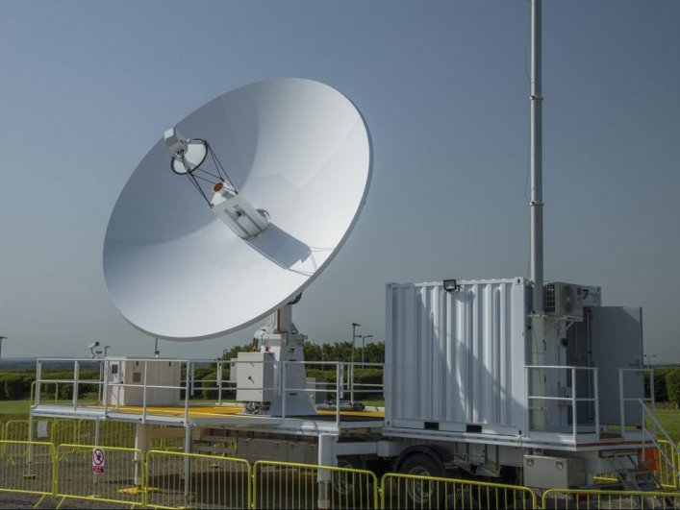
Today: Large Complex Ground Stations
Multi-million dollar investments​
4 to 5 massive ground stations located close to the poles
Image Source: airforce-technology.com
Notes:
However, this current ground station network design has several major shortcomings. First, since there are so few ground stations, a satellite may spend several hours in orbit before actually passing over a ground station in the network. This amounts to hours of latency between the time an image is collected to the time it is actually sent to Earth. Additionally, scaling this ground station network is time consuming and capital intensive since these ground stations are so large and complex. Lastly, since every satellite has only 4 to 5 opportunities to transmit data to Earth, any sort of link degradation such as hardware failures and weather attenuation can have a big impact on the network.

Slide 10
Shortcomings
Large latency (hours)
Scaling is capital-intensive
Failures (e.g. weather) are disruptive
Notes:
However, this current ground station network design has several major shortcomings. First, since there are so few ground stations, a satellite may spend several hours in orbit before actually passing over a ground station in the network. This amounts to hours of latency between the time an image is collected to the time it is actually sent to Earth. Additionally, scaling this ground station network is time consuming and capital intensive since these ground stations are so large and complex. Lastly, since every satellite has only 4 to 5 opportunities to transmit data to Earth, any sort of link degradation such as hardware failures and weather attenuation can have a big impact on the network.

Slide 11
Our System: Low Latency Distributed Downlink (L2D2)
Notes:
To remove these bottlenecks, we design a new system…L2D2.. Which I’ll talk about today.

Slide 12
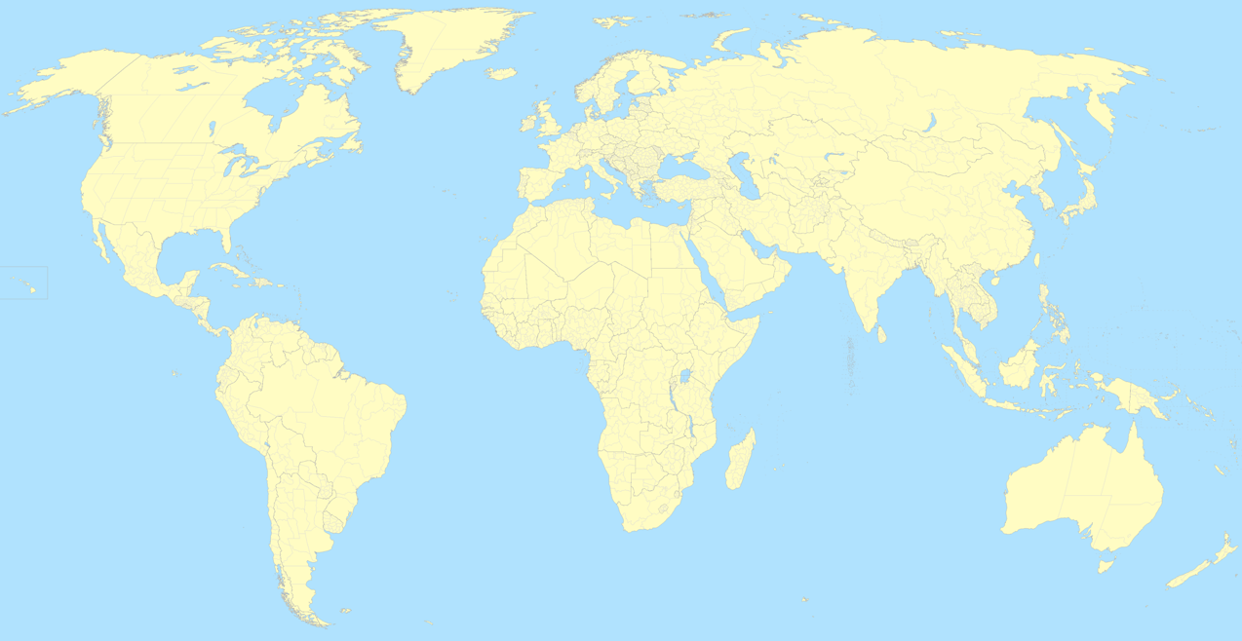
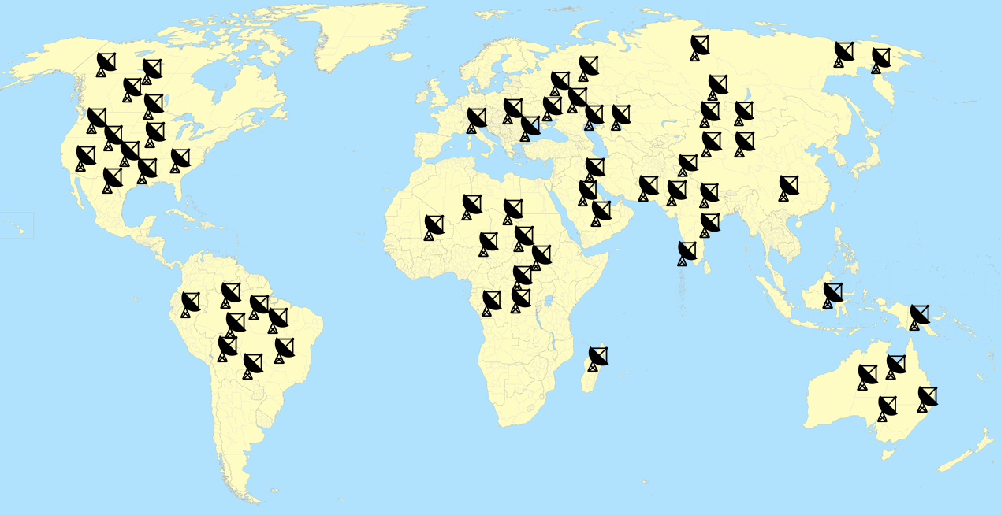
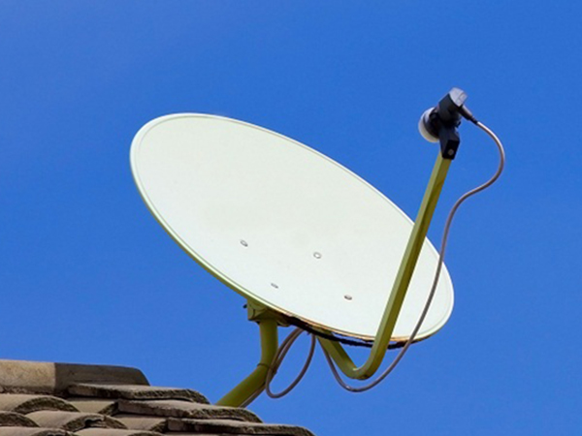
L2D2: Distributed Hybrid Ground Station
Notes:
At the core of L2D2’s design is a distributed hybrid ground station approach. Instead of a network of massive, high complexity ground stations, we propose using many simple, and low cost ground stations. These ground stations can be deployed more easily and quickly in commonplace sites such as backyards and rooftops. Additionally, since these ground stations are so cheap, we can deploy many of them around the world and distribute them geographically. To further simplify these ground stations even further, we can make them receive only since most of the time ground stations in the Earth observation satellite network is used for downloading images. This brings us a larger questions that we try to answer in this work. Can a network of these tiny low complexity ground stations outperform the capital-heavy solution we have today.
Image of tiny groundstation

Slide 13
L2D2: Distributed Hybrid Ground Station
Supercomputers
Cloud Datacenters
Notes:
At the core of L2D2’s design is a distributed hybrid ground station approach. Instead of a network of massive, high complexity ground stations, we propose using many simple, and low cost ground stations. These ground stations can be deployed more easily and quickly in commonplace sites such as backyards and rooftops. Additionally, since these ground stations are so cheap, we can deploy many of them around the world and distribute them geographically. To further simplify these ground stations even further, we can make them receive only since most of the time ground stations in the Earth observation satellite network is used for downloading images. This brings us a larger questions that we try to answer in this work. Can a network of these tiny low complexity ground stations outperform the capital-heavy solution we have today.
Image of tiny groundstation
Move up icons

Slide 14
L2D2: Distributed Hybrid Ground Station
Fault-tolerant
Low Latency
Receive-Only: most ground stations do not transmit
Can a network of tiny ground stations outperform the capital-heavy huge ground stations?
Notes:
At a first glance, L2D2 yields a couple of major benefits. With more ground stations in the network, L2D2 is more fault-tolerant. Any sorts of link disruptions in certain parts of the network can be made up by scheduling satellite-ground links in other parts of the network. Additionally, geographic distribution of ground stations allows satellites more opportunities offload latency sensitive data sooner. Lastly, L2D2 is a hybrid ground station approach where not everyone needs to setup transmit capable ground stations. Unlike the receive only ground stations we propose in L2D2, transmit capable ground stations become much more complicated to setup because they typically require FCC licensing requirements. Even large and reputable companies such as Amazon have spent up to a year trying to secure FCC licenses to build their transmit capable ground stations.

Slide 15
Scheduling Satellite-GS Links
Notes:
Typically, scheduling satellites and ground stations is not a problem today because ground stations in practice talk to only one satellite at a time and satellites only orbit ground stations for about 10 minutes. However, with L2D2 there are many ground stations in the network and with an increasing number of satellites, multiple satellites can compete for one ground station. In fact, we look at this and at any time up to hundred satellites in the L2D2 network can be visible at a time to a ground station, and even the median number of satellites in view of a ground station was around 40 for our experiments. So clearly multiple satellites need to contend for a ground station and as a result we need a satellite-ground scheduling algorithm to optimize downlink.

Slide 16
Scheduling Satellite-GS Links
Notes:
Typically, scheduling satellites and ground stations is not a problem today because ground stations in practice talk to only one satellite at a time and satellites only orbit ground stations for about 10 minutes. However, with L2D2 there are many ground stations in the network and with an increasing number of satellites, multiple satellites can compete for one ground station. In fact, we look at this and at any time up to hundred satellites in the L2D2 network can be visible at a time to a ground station, and even the median number of satellites in view of a ground station was around 40 for our experiments. So clearly multiple satellites need to contend for a ground station and as a result we need a satellite-ground scheduling algorithm to optimize downlink.

Slide 17
Scheduling Satellite-GS Links
Latency
Throughput
Geographic Restriction
$$w=Φ(data)$$
$$w_{1}$$
$$w_{5}$$
$$w_{6}$$
$$w_{2}$$
$$w_{3}$$
$$w_{4}$$
$$w_{7}$$
Notes:
At a first glance, the satellite ground station scheduling problem seems pretty straight forward. We can assign weights to each visible satellite ground station pair at every time step. These weights can be computed by the link estimation algorithm we talked about previously and tuned so we can optimize different aspects of the network such as latency, throughput and geographic restricts (weather a satellite can transmit to ground stations in certain countries for example). And this can map to a standard bipartie graph matching problem.

Slide 18
Scheduling Satellite-GS Links
Switching links takes time
Need to optimize across time
NP Hard!
Notes:
However, this problem is not as intuitive as it initially seems because of this idea that a ground station takes time and incurs cost when switching between satellites In the network. As a result, the satellite ground station matchings are not time independent and the problem becomes NP Hard.
For scheduling 12 min, 34,35,36 only describe problem. Then do results no related work/conclusion

Slide 19
Solution: Greedy Algorithm with Sticky Links
$$w_{1}$$
$$w_{5}$$
$$w_{2}$$
$$w_{3}$$
$$w_{6}$$
$$w_{7}$$
$$w_{4}$$
Notes:
Our solution to this scheduling problem is to develop an approximation greedy algorithm with sticky links. The way it works is as follows. At time step t, we compute and assign weights as we discussed previously to all the satellite ground station pairs in view of each other.

Slide 20
Solution: Greedy Algorithm with Sticky Links
$$w_{1}$$
$$w_{5}$$
$$w_{2}$$
$$w_{3}$$
$$w_{6}$$
$$w_{7}$$
$$w_{4}$$
Time t
Notes:
We find the optimal matchings and choose the blue links and ignore the orange ones.

Slide 21
Solution: Greedy Algorithm with Sticky Links
$w_{1}+w_{1} ∗$b
$$w_{5}$$
$$w_{6}$$
$$w_{7}+w_{7}∗b$$
$$w_{2}$$
$w_{3}+w_{3}∗$b
$w_{4}$+ $w_{4}∗b$
Time t+1
Notes:
But at time step t+1, we need to account for the cost of switching between links. To accomplish this, we assign a bonus weight to all the blue links we chose in the previous time step. These bonus weights are based on the link quality that we obtain from that satellite ground station pair. This essentially makes the schedule “stick” to links that were already chosen in order to minimize any costly switching between satellite ground station pairs.

Slide 22
Problem: Rate Adaptation
Traditional Systems
L2D2
Link Prediction
Ack
Ideal Data Rate
Ideal Data Rate
TX-Capable
RX-Only
Notes:
For 12 min, Start with 29->28->30 (say we use ml skip 31)

Slide 23
Why Link Quality Varies
Satellite Position
Environment Loss (Multipath)
Weather Attenuation
Use ML model to predict SNR and data rate
Rain (Light Rain)
Notes:
To get a better sense of how to solve these challenges, we need to start by looking at how a satellite-ground station link varies over time. Here’s a NASA satellite and as it travels over a ground stations we plot how the quality of it’s link varies over time. At the beginning we start seeing an increase in SNR or signal to noise Ratio, indicating an improvement in the link as the satellite comes into view of the ground stations. Accordingly, we also see that towards the end the link quality degrades as the satellite moves below the horizon and out of view from the ground station. We also take a look at the same satellite ground station pass on a different day when it’s raining, and we see an overall decrease in the SNR as expected. In the middle of the pass however, we typically expect the link quality to be at it’s highest point; however, our measurement here actually dips in the middle and is really noisy. Initially we were confused about this, however we found this is actually do to environmental factors such as multipath. In this case, we believe that the satellite signal is actually reflecting off it’s own solar panel towards the middle of the pass, causing the link quality to degrade. This is a very important aspect of the problem because it demonstrates that the satellite ground station link is highly dependent on hardware and environmental factors specific to the satellite and groundstation pairing.

Slide 24
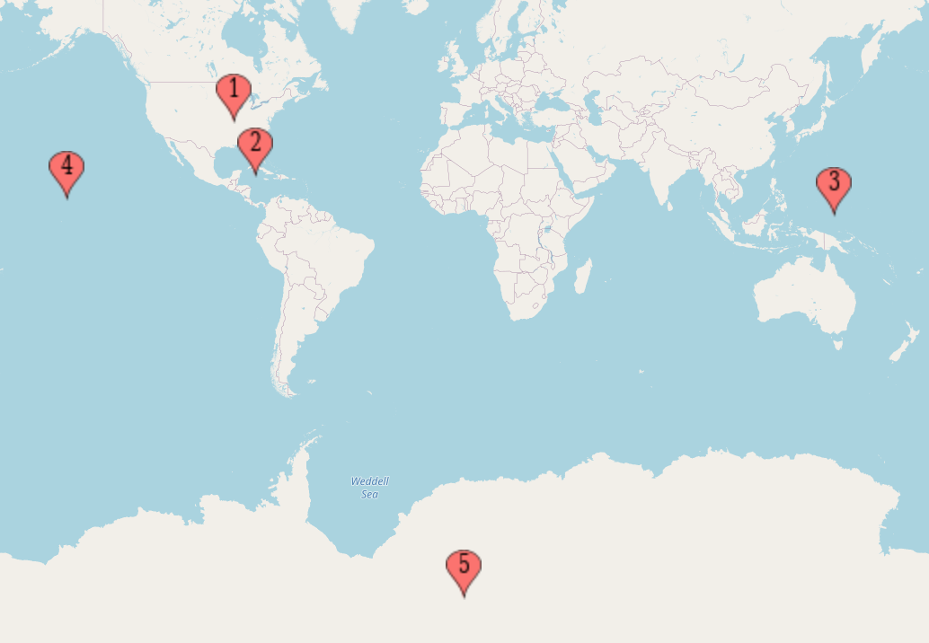
Experiments: Real-world Measurements
5 Ground Stations: Wisconsin, Florida, Guam, Hawaii, Antarctica
4 Satellites: JPSS, SNPP, Aqua, Terra
X-band (8-10Ghz) Downlink: JPSS, SNPP, Aqua, Terra
Ka-band (35-40Ghz) Downlink: JPSS
These datasets have been made public
https://github.com/ConnectedSystemsLab/L2D2
Notes:
We start by using real-world LEO satellite datasets to train and evaluate the link estimation model.
We use measurements across 5 ground stations and 4 satellites in common Earth observation frequency bands. We have about a months worth of data for each satellite ground station pair.
These datasets are open source and can be found by a link below on this slide.

Slide 25
L2D2 ➔ Accurate Link Prediction
Median Datarate Error:
6.25% (L2D2)
41% (ITU)
Notes:
We can start by plotting the SNR error for the link estimation models. On the x-axis we have the SNR error and on the y axis we have CDF. In green is L2D2’s link estimation model and we compare our model to a baseline link estimation model from the ITU. The ITU uses similar features such as weather and satellite position to mathematically predict the SNR. What we can see here is that L2D2’s ML based approach outperforms the ITU model and this translates to a median data rate error of 6.25% for L2D2 and 41% error for the ITU model.

Slide 26
Large Scale Emulation
SatNOGS: Open Source Ground Station Network
259 satellites
173 Ground Stations
100 GB data per day per satellite (26 TB total)
State of the Art: 5 Ground Stations
At least 10X higher median throughput
Notes:
To evaluate other aspects of L2D2, we setup a large scale trace-drive emulation. We use data from the SatNOGS open source ground station network to obtain positional data for 259 satellites and 173 ground stations. However, SatNOGS does not have any link measurements in Earth observation frequency bands so we use the measurements from our link estimation dataset to emulate the satellite ground station links. To conduct experiments, we start by having each satellite generate 100GB of data per day. We run the emulation and have each of the satellites orbit around the Earth and transmit data to ground stations in the L2D2 network. We also setup a baseline experiment where we choose 5 of the 173 ground stations to be high complexity ground stations. We set these ground stations to have 10x higher median throughput.

Slide 27
L2D2 ➔ Lower Latency
Distributed Ground Station reduces latency from hour to minutes
Notes:
First, let’s take a look at latency. On the x-axis, we have latency or time elapsed between data capture and data reception at the ground. On the y axis we have CDF. We first see that L2D2 outperforms the baseline in terms of latency and this is because L2D2 has so many ground stations, and thus, so many more opportunities to transmit data to the ground. However, we also want to also isolate the benefit of geographic diversity and its impact on latency. To this this, we take a subset of 25% of L2D2 ground stations and also compute the latency for this smaller network. What’s interesting is that L2D2 25% has an overall lower aggregate capacity than the baseline and it still significantly outperforms the baseline. Thus, distributed ground stations reduces latency from hours to minutes

Slide 28
Conclusion
L2D2 proposes a new distributed hybrid ground station architecture
It reduces data downlink latency from hours to minutes
Try out our datasets at: https://github.com/ConnectedSystemsLab/L2D2

